Slide 1
Test Summary Report
LEVEL – PRACTIONER

Slide 2
Indumathi Ravinathan (164046), Chandraprabu D (273372)
Indumathi: 7+ Years of experience in Data warehousing domain, Chandraprabu: 9+ Years of experience in IT industry with DW domain
V1.2 3/25/2015

Slide 3









Icons Used
Hands on Exercise
Questions
Tools
Coding Standards
Test Your Understanding
Case Study
Best Practices & Industry Standards
Demonstration
Workshop

Slide 4
Objectives
After completing this session, you will be able to:
Explain test case count and status like executed, failed, passed and blocked, or on hold
Describe the preparation of Defect summary-defects raised, opened, and closed count
Identify risks and issues

Slide 5
Overview
Status report: The status report covers the following:
Test case count and status like executed, failed, passed, and blocked or on hold
Defect summary- defects raised, open and closed count
Risks and issues
Overall summary note
Frequency of Reports
Status reports are delivered daily (DSR), weekly (WSR)and an end report termed as Test Summary report which is given at the end of the testing
Pre requisite:
Before the test execution is started one needs Test plan, Test strategy, Test case sign off

Slide 6
Overview
Conditional sign off:
According to the client some of the test cases are signed off with certain conditions on the requirement behavior or system behavior.
This should be highlighted in the test summary report against the requirement.
Due to environmental issues or code fix getting delayed certain fixes may not be happened in the same SIT cycle, in those cases one can get conditional sign off by mentioning the reason as applicable from the client.
Module 1 will have dependencies with other module which will be deployed after certain period then code fixes of module 1 may not happen in the same SIT cycle, in those cases one can get conditional sign off for those defects of Module 1.

Slide 7
Reports-Overview
Status report:
The status report covers the following:
Test case count and status like executed, failed, passed and blocked, or on hold
Defect summary- defects raised, opened, and closed count
Risks and issues
Overall summary note
Frequency of Reports:
Status reports are delivered daily (DSR), weekly (WSR) and an end report termed as Test Summary report which is given at the end of the testing
Pre requisite:
Before the test execution is started we need for Test plan, Test strategy, Test case sign off
Conditional sign off:
According to the client some of the test cases are signed off with certain conditions on the requirement behaviour or system behaviour.
This should be highlighted in the Test summary report against the requirement.
Due to environmental issues or code fix getting delayed certain fixes may not happen in the same SIT cycle, in those cases one can get conditional sign off by mentioning the reason as applicable from the client.
Module 1 will have dependencies with other module which will be deployed after certain period then code fixes of module 1 may not be happened in the same SIT cycle , in those cases one can get conditional sign off for those defects of Module 1.

Slide 8
Daily Status Report
Introduction:
Generally, this is a communication sent out to establish transparency to the QA team’s activities of the day during the test cycle that includes both defect information and test case run information.
Normally, Development team, Environment support team, Business Analyst and the Project team are the recipients/meeting participants. The Test plan is the best place for one to find this information.
What does a daily status report contain?
Number of test cases planned for that day
Number of test cases executed – that day
Number of test cases executed overall
Number of defects encountered that day/and their respective states
Number of defect encountered so far/and their respective states
Number of critical defects- still open
Environment downtimes – if any
Showstoppers – if any
Attachment of the test execution sheet / Link to the test management tool where the test cases are placed
Attachment to the Defect report/link to the defect/test management tool used for incident management
What are the activities planned next?
Does the user need any inputs from any of the other teams and if so, what?

Slide 9
Daily Status Report - Sample 1
Daily Status Report should be sent through mail on daily basis with the below details,
FROM: Our Mail-ID
TO: Project Stakeholders
CC: Team Members
SUBJECT: Project Name -SIT Daily Status Report-mm/dd
Content:
Color Description:
Green – If the test execution can be completed within the date mentioned for Sign Off
Yellow – If the team is facing some challenges to meet the Sign off date due to delay in deployment or environment is not ready for testing/downtime/due to huge defects which will take time to re-test with regression
Red – It the team is blocked with test execution. Also need to mention in the mail about the blocking issue.

Slide 10
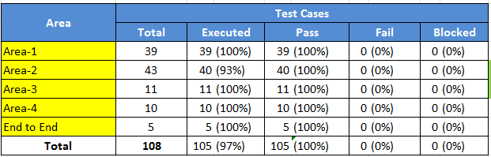
Daily Status Report – Sample 1 (Contd.)
Test Case Metrics:
Test Case Metrics should contain the following contents:
Status: Green
Test execution completion: 97%
Total No. of TC’s for each area
Total Number of TC’s Executed and Executed % (Pass % should be (Total Executed/Total)*100)
Total number of TC’s Passed and Passed % (Pass % should be (Total Executed/Total)*100)
Total Number of TC’s Failed and Fail % (Fail % should be (Total Fail/Executed)*100)
Total Number of TC’s Blocked and Blocked % (Blocked % should be (Total Blocked/Total)*100)

Slide 11
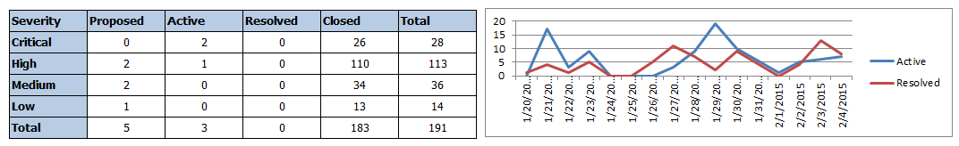
Daily Status Report – Sample 1 (Contd.)
Defect Metrics:
Report should contain the metrics between the defect severity and the defect status.
Proposed Defects:
Proposed defects are the new defects which are logged on the current day and should be mentioned in the Daily Status Report which will be accessible to the stake holders to find the new defects.
ID | Severity | Defect_Priority | Title

Slide 12
Daily Status Report-Sample 2
Test Execution Report
This Document tracks the test execution status for Match and Merge rules Testing Phase
Project Details
Project Name | XZZ
Test Phase | Testing Phase
Environment | Test Environment
Report Date | 2/11/2015
Status | Green
Overall System Testing Status – Business rules Testing Phase
Test Type | Stages | Testing Status |  |  |  |  |  |  |  | Total Defects | Open Defects | Closed Defects
 |  | Total Test Cases | Executed | Passed | Failed | In Progress | Blocked/ On Hold | Not Started | %Executed
Business rules Testing | Match rules validation | 18 | 18 | 15 | 3 | 0 | 0 | 0 | 100% | 1 | 1 | 0
 | Merge rule validation | 33 | 16 | 15 | 1 | 0 | 17 | 0 | 48% | 1 | 1 | 0
 | Total | 51 | 34 | 30 | 4 | 0 | 17 | 0 | 67% | 2 | 2 | 0
SIT Defects Summary :
Sl No | Defect ID | Defect Description | Status | Detected Date | Closed Date
1 | DFCT0013249 | Target table [INT_INDIV_KEY_REG] has no keys specified | Open | 2/6/2015
2 | DFCT0013272 | Merge Outbound Tables not loaded with updated data_INDIV_PHONE and INDIV_XREF | Open | 2/11/2015
Summary Note: The execution status is on track till date.

Slide 13
SIT –DSR Summary
Summary :
The execution status is on track till date.
Show stopper :
The test cases are on hold due to workflow failures, this is a blocking issues which need high attention.
Risks
If the blocking defect is resolved then there will not be any delay in meeting the deadline for SIT
The risks should be tracked in a detailed manner with the type of risk, mitigation, owner, target date

Slide 14
Risk Trackers- Sample
Top Three Risks
# | Description | Risk Owner | Actions Planned to Mitigate | Risk Magnitude
1 | Sign off's on the approach documents and ER diagram is pending. | XXXX | Dcouments shared are not signed off,we should initate meetings to get sign off. | High
2 | Gap in the mapping between BQT & CRMM tables for data conversion. Lack of knowledge in BQT & CRMM data. | XYX | Working with VDSI & CRMM team to address the gap | Medium
3 | The grooming scope to be confirmed. | XXX | Weekly call is setup to discuss to address the scope item. Work with Roshik mohamed to finalize the requirement | High
Risk Register- Risk Management & Exposure Summary
RISK IDENTIFICATION
Risk ID | Risk Name | Risk Description | Risk Impact | Mitigation | Criticality | Date Raised | Planned Closure | Risk Owner | Risk Status
R 1 | Access to N/W | Vz id created, but access to network not yet established. | Impact on requirements |  | High | 09-Apr-14 | 09-May-14 | yth | Mitigated
R2 | NO Technical KT on BQT Bundles,DTV,PSTN | KT is on functional side and not on technical, understanding the current state without documents will potentially impact technical solution. | Impact on SSP Data Model, Conversion mapping / approach document. | Identify the gaps and present it in daily scrum | Medium | 21-Apr-14 | TBD | Xwd | Open

Slide 15
Weekly Status Report
Introduction:
Weekly status report provides an ongoing history of the project, which becomes very useful in terms of tracking progress, evaluation, and review.
Weekly status reports form a part of the Project Review Process both during and after completion of the project.
Weekly status report identifies the key areas of importance that will assist the stakeholders of the project in determining the “state” of the software development and test efforts.
Test Lead tries to maintain a careful balance between timeliness, accuracy, and consistency when preparing these reports as the status of the defects keeps changing.
Who should use it? The target audience for a weekly status report could vary. Any one interested on project health can be the audience. This can be the Project Management team, Project Steering committee, Customer, or other key stakeholders of the project

Slide 16
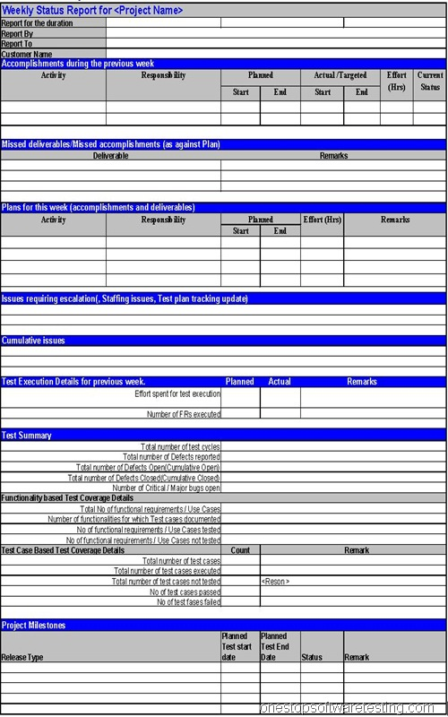
Weekly Status Report (Contd.)
A brief description of the different attributes of weekly status report are shown in the figure.
1. Project Name: The project name that one is reporting metrics on 2. Duration: The reporting period 3. Report by: Owner/Author of the report 4. Report to: Target audience 5. Previous weeks accomplishment: Activities performed after last reporting date 6. Missed accomplishment: Not able to work on any planned activity of the previous report 7. Plans for this week: Future planning for the tasks to be performed during the current reporting period
8. Issues: The role of a Test Lead is to give approximate if not accurate reports on the status of the project. At the start of test execution, Test Lead presumes that all the risks to be addressed by this phase of testing still exist. As the user progress through the test plan, one by one, risks are cleared as all the tests that address each risk are passed. Halfway through the test plan, the tester can say, “We have run some tests, these risks have been addressed, here are the outstanding risks of release.”

Slide 17
Weekly Status Report (Contd.)
9. Cumulative Issues– Issues from previous report, if not addressed, should be listed here.
10. Test execution Details for previous week:
- Test details for the reporting period
- Total effort spent on test execution - Total number of functionality tested during the reporting period
11. Test Summary:
- Total number of test cycles, number of defects found, and defect tracking details should be listed in this section
- Test coverage details in terms of functionalities tested and test cases executed should be detailed in this section
12. Project Milestone:
- Important project schedule from a testing point of view should be listed here

Slide 18
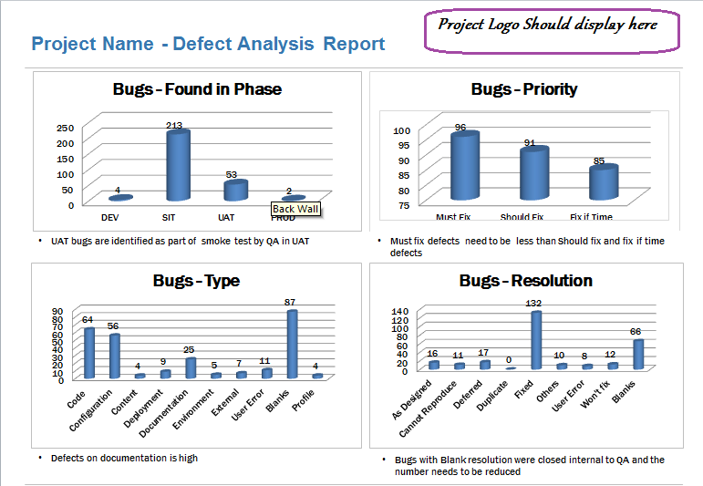
WSR - Defect Analysis Report
The weekly status report should also represent the status through charts and graphs for easy and better understanding.
DEFECTS
DEFECTS
DEFECTS
DEFECTS

Slide 19
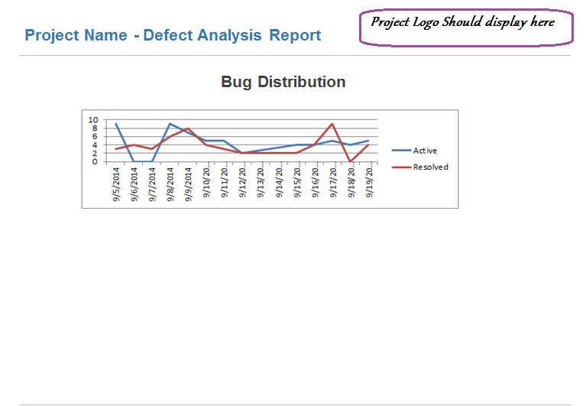
WSR -Defect Analysis Report
The weekly status report can also be represented in the form of line chart as shown below.

Slide 20
Test Your Understanding
What is Conditional sign-off and state its importance in status reports?
What are the key points of the status reports?
What are to be covered in a DSR?
What is the main content of a WSR?
To whom should DSR be addressed?
What colour in DSR states that you are in track with the timelines?

Slide 21
Summary
At the end of the course, you have learned the following:
The status report covers test case count and status like executed, failed, passed and blocked or on hold, defect summary, risks and issues, and overall summary note.
Conditional sign-off: According to the client some of the test cases are signed off with certain conditions on the requirement behaviour or system behavior.
Generally, DSR is a communication which is sent out to establish transparency to the QA team’s activities of the day during the test cycle. This includes both defect information and test case run information.
Weekly status reports form a part of the Project Review Process both during and after completion of the project.
Test Summary includes the following:
-Total number of test cycles, number of defects found, and defect tracking details should be listed in this section
-Test coverage details in terms of functionalities tested and test cases executed should be detailed in this section.

Slide 22

Source
Wikipedia
Disclaimer: Parts of the content of this course is based on the materials available from the Web sites and books listed above. The materials that can be accessed from linked sites are not maintained by Cognizant Academy and we are not responsible for the contents thereof. All trademarks, service marks, and trade names in this course are the marks of the respective owner(s).

Slide 23
You have successfully completed

